Slide 1
Stock-Market Analysis
BI Tool – Power Bi

Slide 2
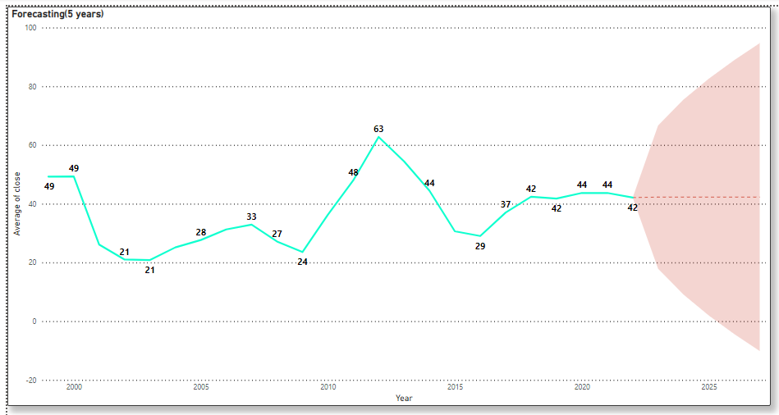
Prediction – Forecasting Chart The model takes closing price and volume traded of all companies historical data as inputs giving future prices/suggestions on buying or selling for the stock for next 5 years.

Slide 3
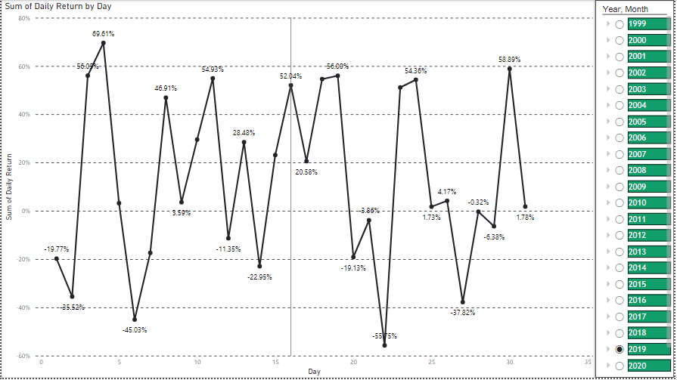
Daily Return This chart displays daily return % potential of each stock.

Slide 4
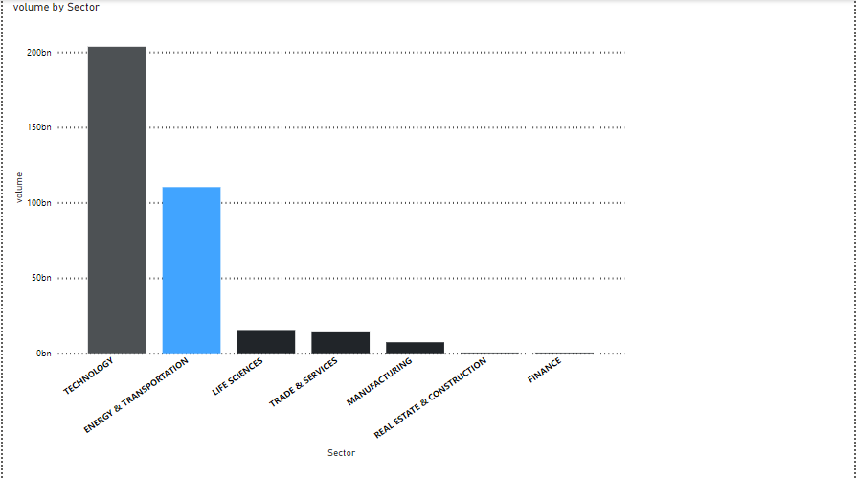
STOCK VOLUME This chart provides us the sector in which the highest volume stock has been traded.

Slide 5
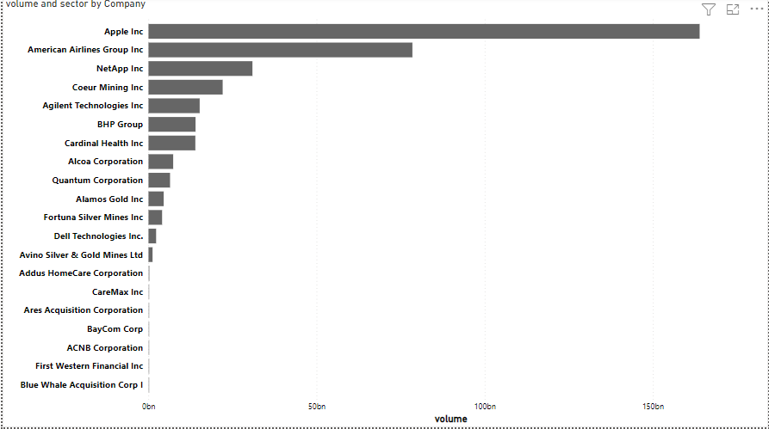
Top Companies This chart displays the companies stock which has been traded highly.

Slide 6
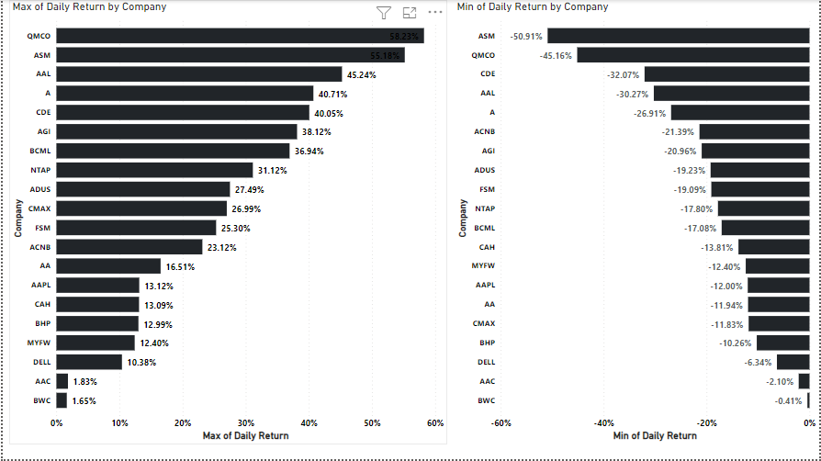
Min. Daily Return vs Max.Daily Return (%) This charts shows the comparison between the stocks based on their daily returns.

Slide 7
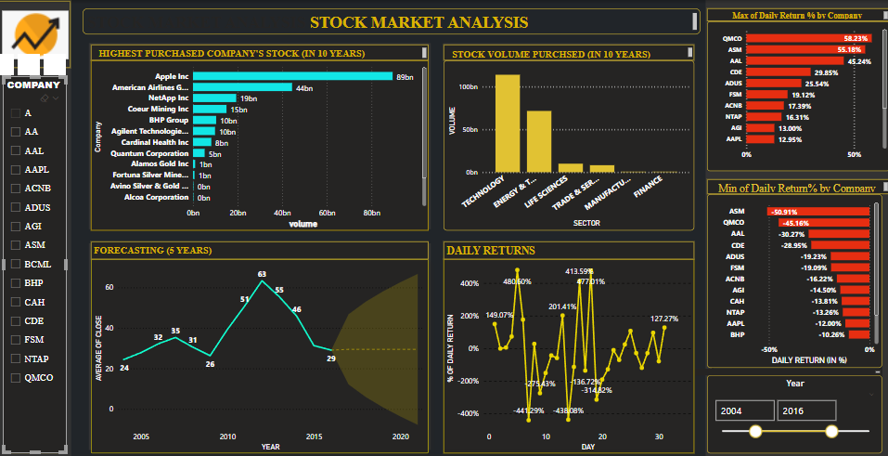
DashBoard

